Slide 1
Comparing Two Means
Prof. Andy Field

Slide 2
Aims
T-tests
Dependent (aka paired, matched)
Independent
Rationale for the tests
Assumptions
Interpretation
Reporting results
Calculating an Effect Size
Categorical predictors in the linear model.

Slide 3
Experiments
The simplest form of experiment that can be done is one with only one independent variable that is manipulated in only two ways and only one outcome is measured.
More often than not the manipulation of the independent variable involves having an experimental condition and a control.
E.g., Is the movie Scream 2 scarier than the original Scream? We could measure heart rates (which indicate anxiety) during both films and compare them.
This situation can be analysed with a t-test

Slide 4
T-test
Dependent t-test
Compares two means based on related data.
E.g., Data from the same people measured at different times.
Data from ‘matched’ samples.
Independent t-test
Compares two means based on independent data
E.g., data from different groups of people
Significance testing
Testing the significance of Pearson’s correlation coefficient
Testing the significance of b in regression.

Slide 5


Rationale to Experiments
Group 1
Group 2
Lecturing Skills
Variance created by our manipulation
Removal of brain (systematic variance)
Variance created by unknown factors
E.g. Differences in ability (unsystematic variance)

Slide 6
Rational for the t-test
Two samples of data are collected and the sample means calculated. These means might differ by either a little or a lot.
If the samples come from the same population, then we expect their means to be roughly equal. Although it is possible for their means to differ by chance alone, we would expect large differences between sample means to occur very infrequently.
We compare the difference between the sample means that we collected to the difference between the sample means that we would expect to obtain if there were no effect (i.e. if the null hypothesis were true). We use the standard error as a gauge of the variability between sample means. If the difference between the samples we have collected is larger than what we would expect based on the standard error then we can assume one of two:
There is no effect and sample means in our population fluctuate a lot and we have, by chance, collected two samples that are atypical of the population from which they came.
The two samples come from different populations but are typical of their respective parent population. In this scenario, the difference between samples represents a genuine difference between the samples (and so the null hypothesis is incorrect).
As the observed difference between the sample means gets larger, the more confident we become that the second explanation is correct (i.e. that the null hypothesis should be rejected). If the null hypothesis is incorrect, then we gain confidence that the two sample means differ because of the different experimental manipulation imposed on each sample.

Slide 7
Rationale to the t-test
t | = | observed difference between sample means | − | expected difference between population means (if null hypothesis is true)
 |  | estimate of the standard error of the difference between two sample means

Slide 8
The Independent t-test

Slide 9
The Dependent t-test

Slide 10
Assumptions of the t-test
Both the independent t-test and the dependent t-test are parametric tests based on the normal distribution. Therefore, they assume:
The sampling distribution is normally distributed. In the dependent t­-test this means that the sampling distribution of the differences between scores should be normal, not the scores themselves.
Data are measured at least at the interval level.
The independent t-test, because it is used to test different groups of people, also assumes:
Variances in these populations are roughly equal (homogeneity of variance).
Scores in different treatment conditions are independent (because they come from different people).

Slide 11
Independent t-test Example
Are invisible people mischievous?
24 Participants
Manipulation
Placed participants in an enclosed community riddled with hidden cameras.
12 participants were given an invisibility cloak.
12 participants were not given an invisibility cloak.
Outcome
measured how many mischievous acts participants performed in a week.

Slide 12
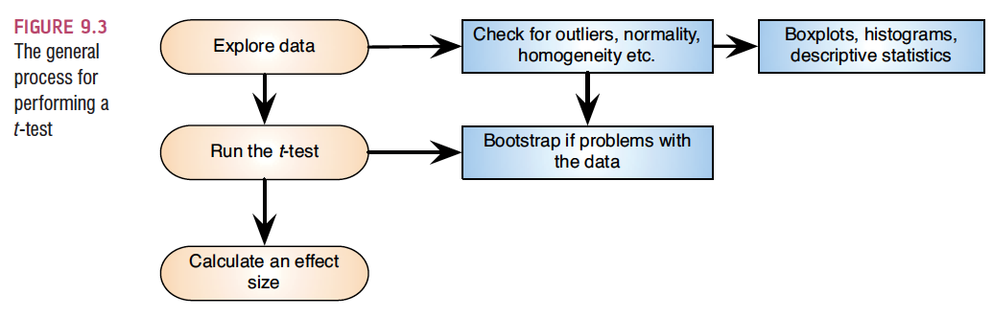
Independent t-test using SPSS

Slide 13
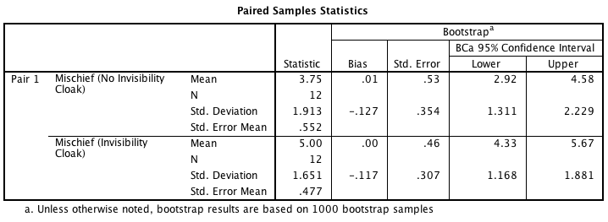
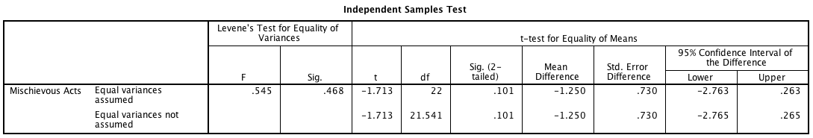
Independent t-test Output

Slide 14
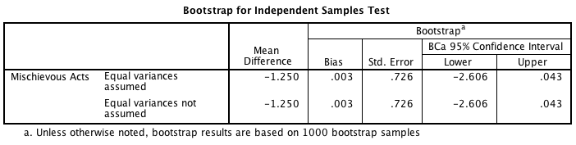
Bootstrapping Output

Slide 15
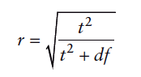
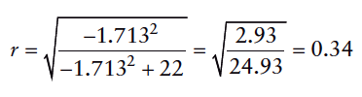
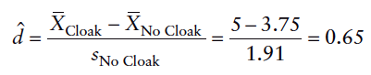
Calculating the Effect Size

Slide 16
Reporting the independent t-test
On average, participants given a cloak of invisibility engaged in more acts of mischief (M = 5, SE = 0.48), than those not given a cloak (M = 3.75, SE = 0.55). This difference, −1.25, BCa 95% CI [−2.606, 0.043], was not significant t(22) = −1.71, p = .101; however, it did represent a medium-sized effect d = .65.

Slide 17
Matched-samples t-test Example
Are invisible people mischievous?
24 Participants
Manipulation
Placed participants in an enclosed community riddled with hidden cameras.
For first week participants normal behaviour was observed.
For the second week, participants were given an invisibility cloak.
Outcome
measured how many mischievous acts participants performed in week 1 and week 2.

Slide 18
Paired- samples t-test Output

Slide 19
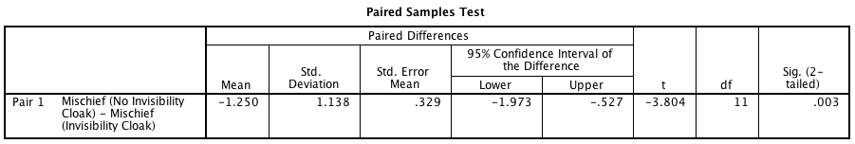
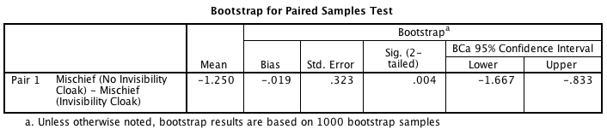
Paired- samples t-test Output Continued

Slide 20
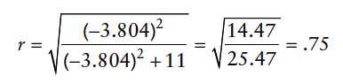
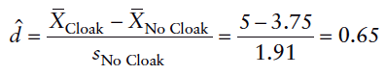
Calculating an Effect Size

Slide 21
Reporting the paired-samples t-test
On average, participants given a cloak of invisibility engaged in more acts of mischief (M = 5, SE = 0.48), than those not given a cloak (M = 3.75, SE = 0.55). This difference, −1.25, BCa 95% CI [−1.67, −0.83], was significant t(11) = −3.80, p = .003 and represented a medium-sized effect d = .65.

Slide 22
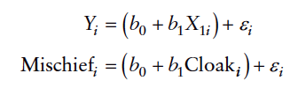
Categorical predictors in the linear model

Slide 23
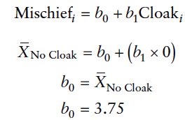
Cloak group
The group variable = 0
Intercept = mean of baseline group

Slide 24
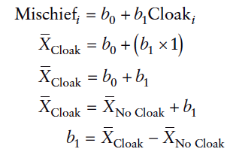
No Cloak Group
The group variable = 1
b1 = Difference between means

Slide 25
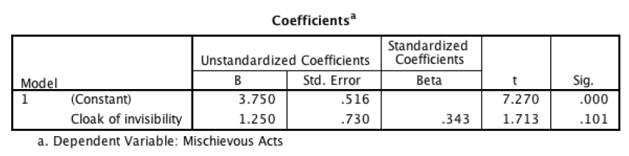
Output from a Regression

Slide 26
When Assumptions are Broken
Dependent t-test
Mann-Whitney Test
Wilcoxon rank-sum test
Independent t-test
Wilcoxon Signed-Rank Test
Robust Tests:
Bootstrapping
Trimmed means

